Slide 1

A New Concept using LSTM Neural Networks for Dynamic System Identification
Neural networks and deep learning
Presenters : omid Vaheb , Mahsa masoud

Slide 2
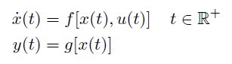
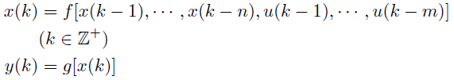
Introduction
Neural Networks
LSTM
The use of LSTM for system identification in control field has never been addressed by any existing literature
Nonlinearity
Speed Requirement
state-space

Slide 3
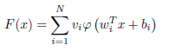
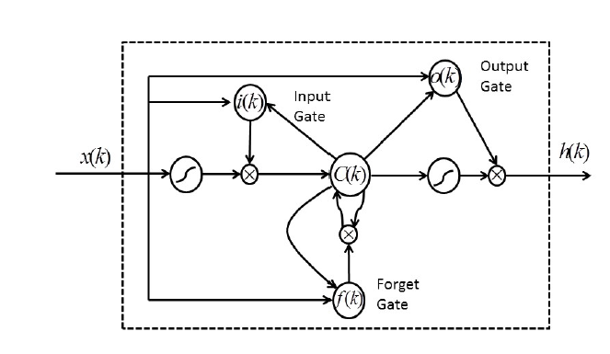
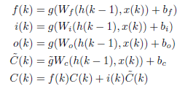
Theoretical base
The Stone-Weierstrass Theorem => a nonlinear equation under certain conditions can be represented by series like Wiener series
The Universal-Approximation Theorem
LSTM with Gated Units

Slide 4
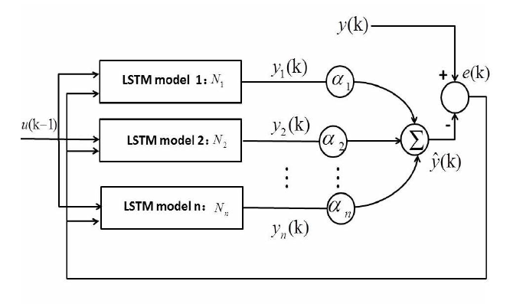
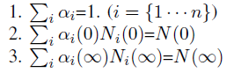
Convex-based LStm
Universal Approximation Theorem => when appropriate activation functions and number of hidden nodes are chosen, the LSTM RNN structures can identify any nonlinear system
Adaptive Control and Machine Learning => Multiple Models
Second Level Adaptation => increases the convergence speed during system identification
Structure of the convex-based LSTM networks

Slide 5
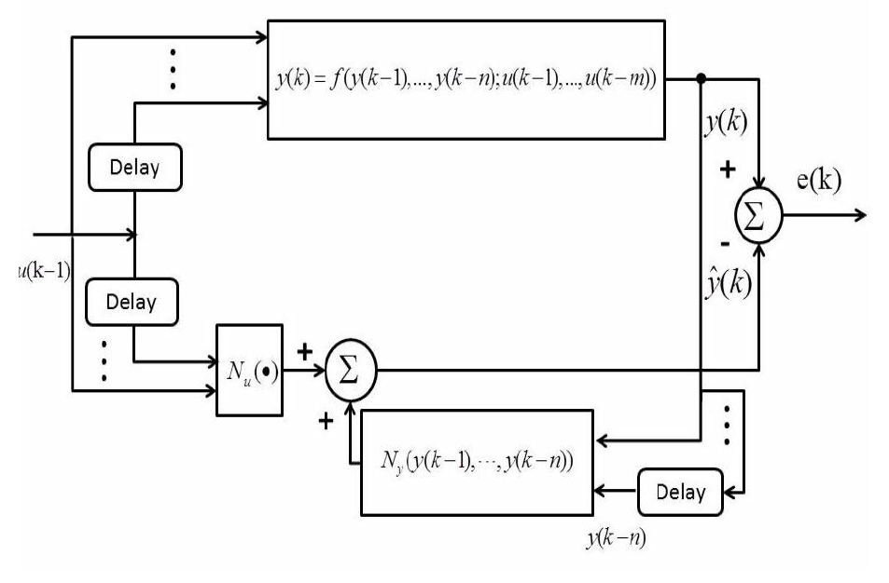
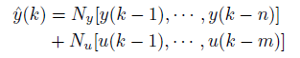
Identification using LSTM Neural Networks
Series-Parallel Identification Model => takes advantage of both the output signal from the real plant and from the estimator.

Slide 6
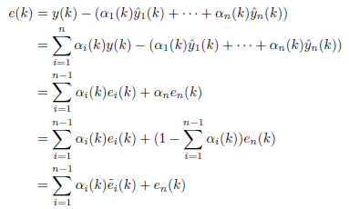
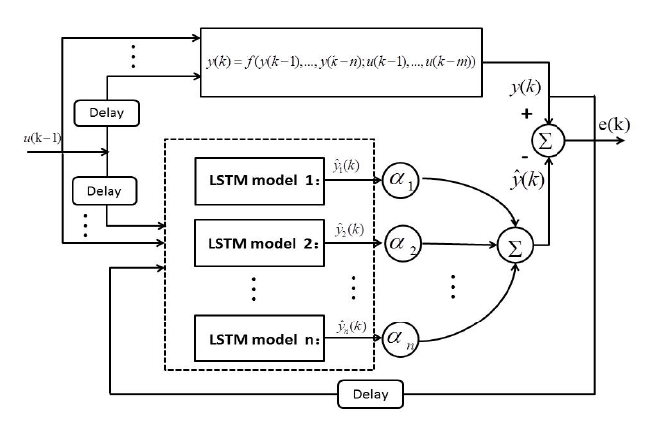
A NEW ADAPTIVE LEARNING APPROACH FOR CONVEX-BASED LSTM NEURAL NETWORK

Slide 7
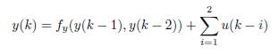
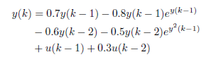
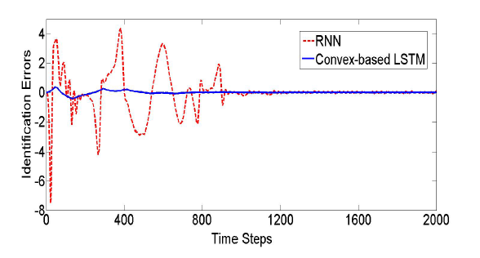
Results and conclusion
Simulation
Conclusion

Slide 8
References
Yu Wang, "A new concept using LSTM Neural Networks for dynamic system identification," 2017 American Control Conference (ACC), 2017, pp. 5324-5329, doi: 10.23919/ACC.2017.7963782.

Slide 9
Thanks for your attention

